Slide 1

DIGITAL PATIENT COMPANION
Check Upp
Keep people on track with preventive care — screenings, referrals, and follow-ups — with a single, patient-friendly companion.
Founder: Dr Sheila Uyirwoth
Australia • 2026
Pitch deck
Check Upp • 2026

Slide 2
PROBLEM
Preventive care falls through the cracks.
Patients miss screening milestones (cancer screening, antenatal schedules, childhood vaccinations).
Referrals, pathology forms, and eScripts are fragmented across systems and paper.
Clinics spend time on recalls and admin, but still struggle to close the loop.
The result: later diagnosis, avoidable cost, and inequity for CALD and First Nations communities.
Problem
Check Upp • 2026

Slide 3
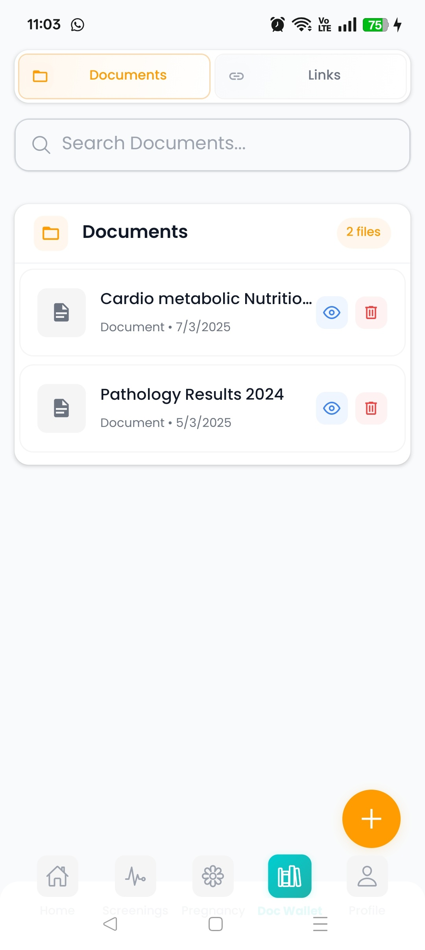
SOLUTION
A digital patient companion that closes the loop.
Personalised check-up plan
A timeline of recommended preventive care and follow-ups, tailored to age, sex, and risk factors.
Reminder + evidence capture
Smart reminders and status tracking that helps patients complete actions and helps clinics confirm completion.
Centralised document wallet
One place for referrals, eScripts, pathology requests and results, and care instructions.
Solution

Slide 4
GO-TO-MARKET WEDGE
Start with high-impact programs, expand to lifelong care.
First wedge
Next
Then
Cancer screening recall support for GP clinics and PHNs.
Antenatal care pathways and structured follow-ups.
Childhood vaccination schedules and catch-up reminders.
Also supports
Equity
Pre-employment medicals and occupational health workflows for faster completion and better record-keeping.
Better navigation and reminders for CALD and First Nations communities (with culturally safe design partnerships).
Market entry and expansion
Check Upp • 2026

Slide 5
TRACTION
Built prototype. Ready for pilot evidence.
What exists today
Pilot design (90 days)
A working app prototype for reminders, check-up logbook, and document wallet.
2 clinics + 1 PHN partner
Primary outcome: completion rate
Secondary: time saved, NPS, retention
Deliverable: grant- and investor-ready evaluation report
What we will prove in pilots
Higher completion of screening actions and lower admin burden for clinics.
Ask (today)
Download and test the app
15–20 minute user interview
Intro to a PHN for pilot partnership
Traction
Check Upp • 2026

Slide 6
BUSINESS MODEL
B2B2C: clinics and PHNs pay; patients benefit.
Core customer
Pricing (example)
End users
GP clinics
Primary Health Networks
$X per clinic per month
+ optional per-patient program fee
Patients and carers
Value to clinics/PHNs
Value to funders/grants
Improved recall completion
Reduced admin time
Clear program reporting
Better patient experience
Measurable prevention outcomes
Equity focus
Scalable digital delivery
Evaluation-ready pilot design
Business model
Check Upp • 2026

Slide 7
TEAM
Clinical credibility + execution.
Founder
What we are hiring/adding
Dr Sheila Uyirwoth
Specialist Occupational & Environmental Physician and Specialist GP
Experienced in preventive care pathways and clinical governance
Product (patient UX)
Engineering
PHN partnerships
Evaluation / health economics
Advisors (target profile)
Primary care leader • Public health / screening program expert • Data privacy/security • First Nations health leader
Team
Check Upp • 2026

Slide 8
TRACTION (EARLY VALIDATION)
Smoke test completed. Clear fixes, clear path to pilot readiness.
What we validated
What we learned (pilot blockers)
Early real-world QA is underway using the target device class for broad access.
We have reproducible defects and a prioritized remediation plan.
Reliability, activation friction, data persistence, and immunisation workflow safety checks are the key readiness gates.
90-day build-to-pilot plan (from this smoke test)
Fix stability on low-end devices • Add explore mode • Persist user data across sessions • Add immunisation validation rules + schedule viewer • Re-test on target devices
Traction and readiness
Check Upp • 2026

Slide 9
WHY WE WIN
Closing the loop beats reminders.
What most tools do
What Check Upp does
They either
• live inside clinic systems (patients don't see them)
or
• remind patients (clinics can't verify completion)
A patient-first companion that
• tracks actions + evidence
• stores the right documents
• supports program reporting for clinics/PHNs
Defensibility
Scalability
Equity advantage
Workflow integration + evaluation evidence
Partner distribution via PHNs
Trust from clinical governance
Replicable care pathways
Low marginal cost per program
Supports multiple populations across a lifetime
Purpose-built for CALD and First Nations delivery in partnership
Simple UX for low digital literacy
Differentiation and defensibility
Check Upp • 2026

Slide 10
THE ASK
Help us run the pilot and prove impact.
Introductions to 1 Primary Health Network (PHN) and 2 pilot clinics
Non-dilutive: grant partner for evaluation and equity outcomes
Seed funding to complete product, integrate workflows, and scale pilots
Contact
Email: askcheckupp@gmail.com
Next step: book 20 minutes for a demo + pilot fit
Contact
Check Upp • Contact

